Slide 1

Sneaker Classification Final Presentation
By: Shahan Rahman, Hasibul Islam, Jun Zheng & Carlos Vides

Slide 2

Problem Statement
Given still images of sneakers, identify one or more sneaker companies in the image using a stored database of sneakers.

Slide 3
Companies
Notes:
We needed to decide what companies to have our algorithm choose and predict from. So..

Slide 4



Types of Classifications
We classify three different companies
Puma
Nike
Adidas

Slide 5
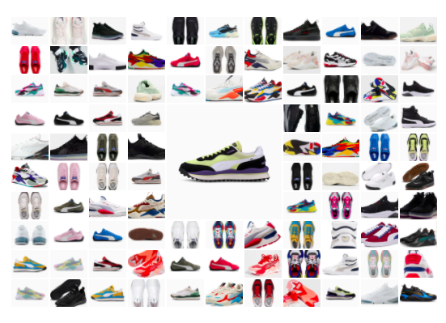
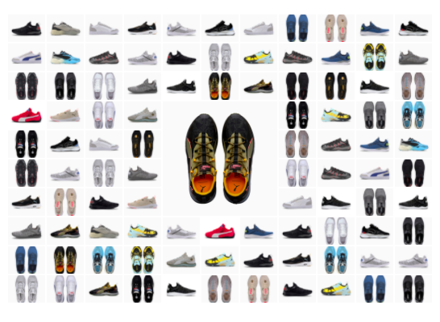
Puma Training-Image
Notes:
Talk about the size of the dataset and different angles we have the photos.
141 pc
Stock images like from foot locker
And some extreme cases that look like someone is wearing the pair of shoes

Slide 6
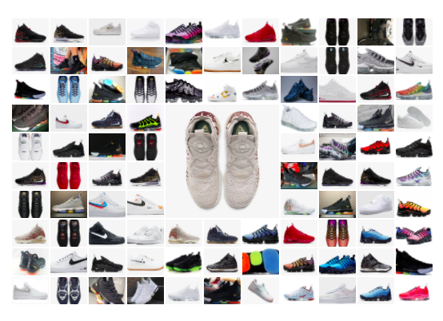
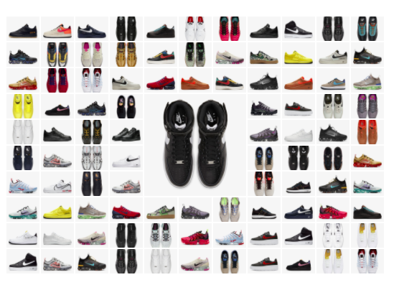
Nike Training-Image
Notes:
187 picture

Slide 7
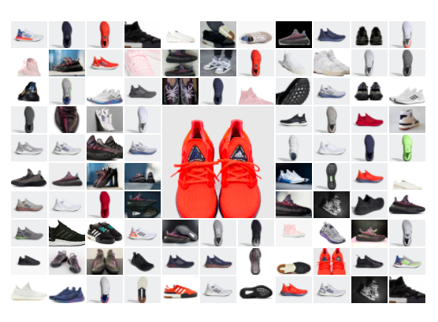
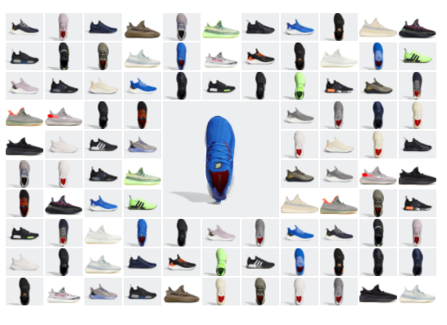
Adidas Training-Image
Notes:
175 picture

Slide 8
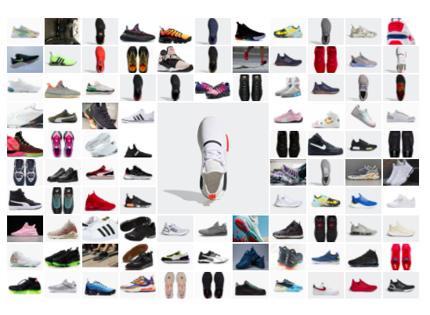
Test
I
M
A
G
E
s
01
Test Images
Notes:
100 test image
1 35 nike
36-67 puma
68-100 adidas
Just to model to understand

Slide 9
Final Result

Slide 10
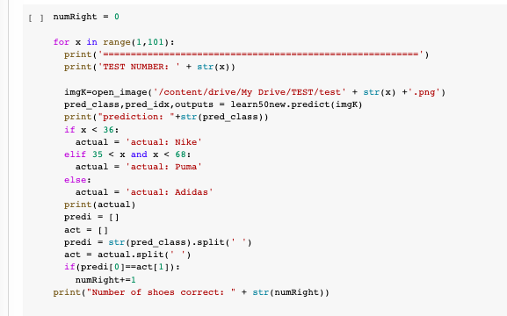
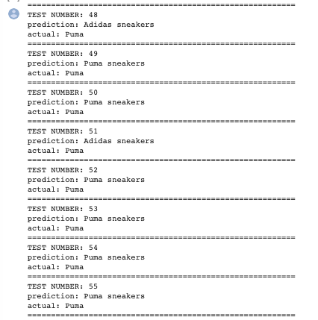
01
What Our Results Looks Like?
Notes:
The left image shows our code where we iterate through our test images and predict the outcome. This allows the output to show on the right where each shoe is predicted and then the actual shoe is printed below it.

Slide 11
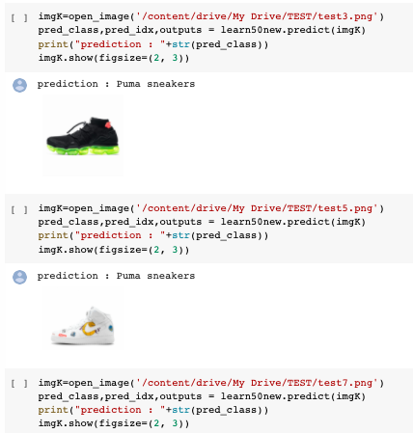
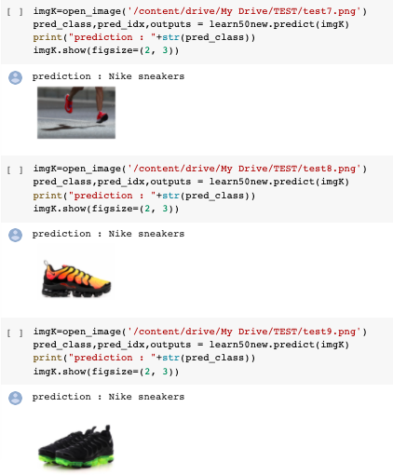
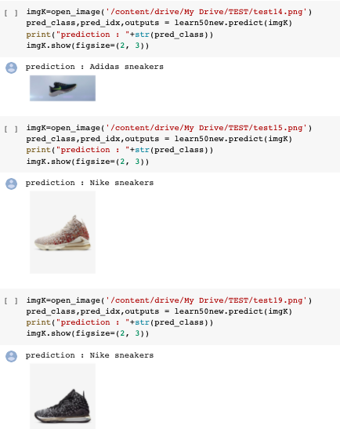
01
What Our Results Looks Like?
C
O
D
E
Notes:
These images show how an individual shoe is predicted, since we cannot render all the figures for each shoe, we only displayed a random eight and showed what image actually went into our prediction.

Slide 12

Result
The google colab work is now in its final phase were we got our last result with 92% accuracy.
We will show you how we got to this point later in the presentation.

Slide 13
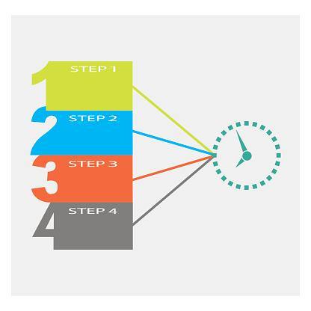
01
Broken Down Into Pieces
Our first steps into testing out data with Connor Shorten’s Algorithm
We broke the project into 3 parts:
Second Step to achieve better accuracy.
Lastly our final product and results
Notes:
WE BROKE THE PRESENTATION UP INTO THREE PARTS WHERE IN THE FIRST PART WE LOOKED AT…
THEN IN OUR SECOND PHASE WE LOOKED INTO DIFFERENT TECHNOLOGIES TO IMPROVE OUR ACCURACY
LASTLY OUR FINAL PRODUCT

Slide 14
Connors Algorithm

Slide 15
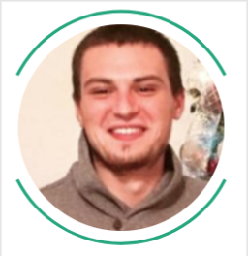

Shorten’s Classifier
01
Nike & Adidas Classifier
140 images
91% Accuracy
4 Layer Convolutional Network

Slide 16
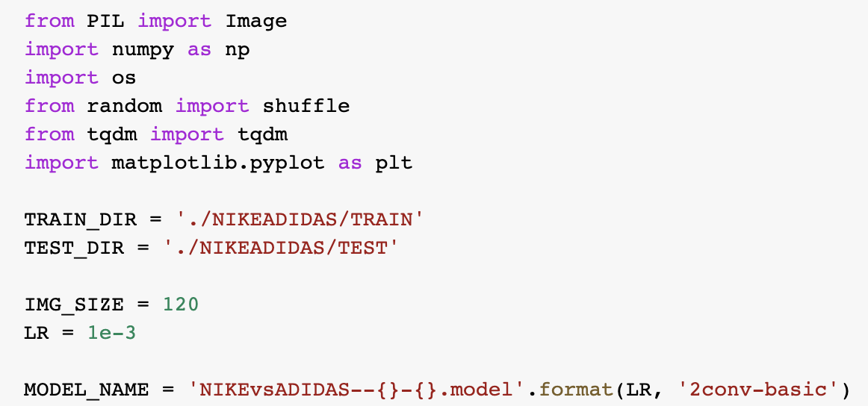
Shorten’s Dependencies
PIL
NUMPY
OS
RANDOM
TQD
MMatplotlib.py

Slide 17

Shorten’s Code 1
2 different functions to load training data
A function to label images
A function to create the training data using matplotlib
CNN
A function for data splitting
A function to fit the model and train the model using fit()

Slide 18
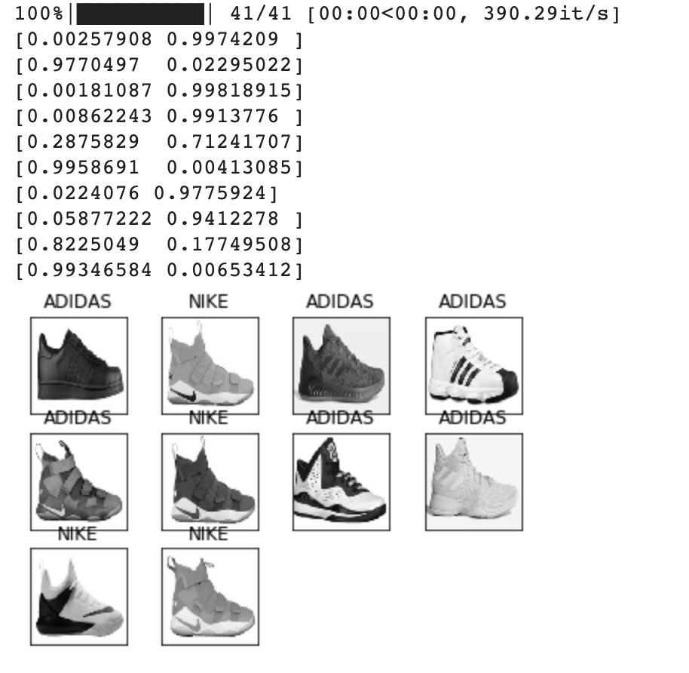
Shorten’s Code 2
10 shoes
99.7% accuracy for Adidas
.2% for Nike

Slide 19
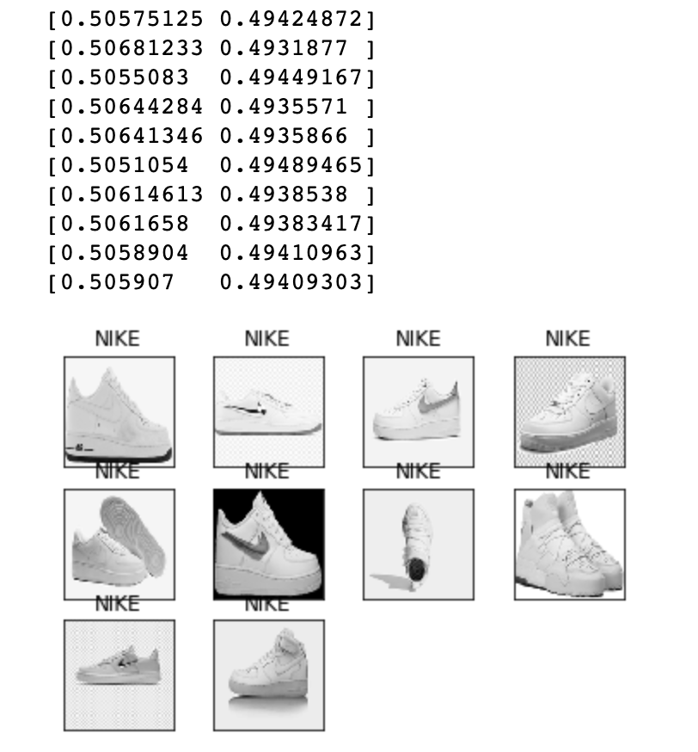
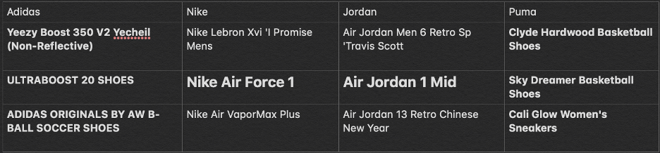
Shorten’s Classifier Using Our Images
Problems !
49%-50% Accuracy

Slide 20
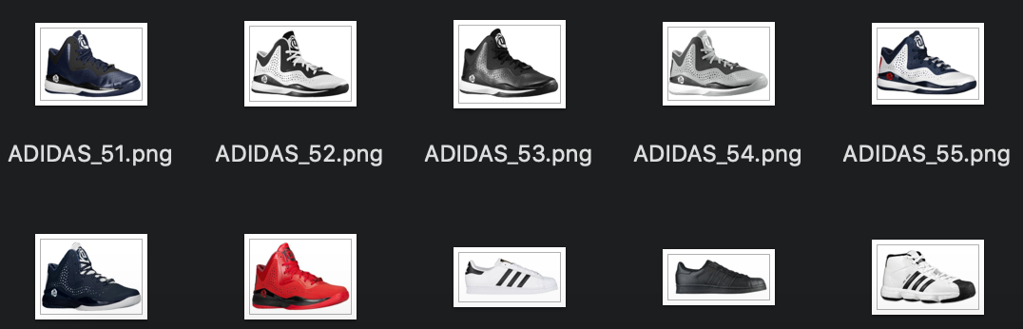
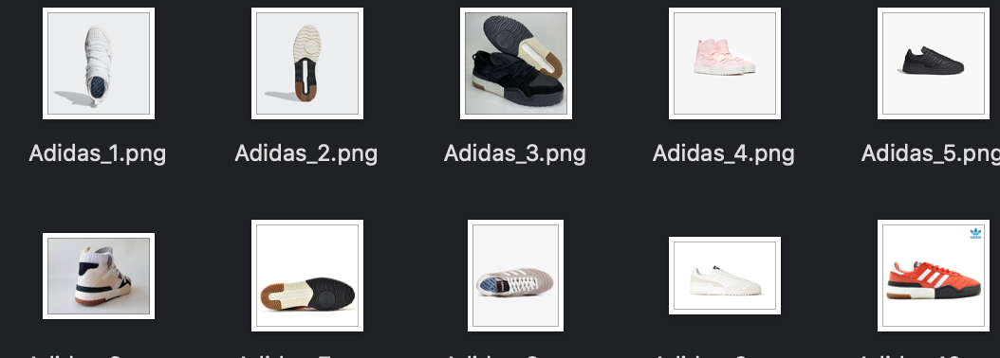
Extreme Cases or ‘Outliers’ 1
Better quality images
Removed outliers

Slide 21
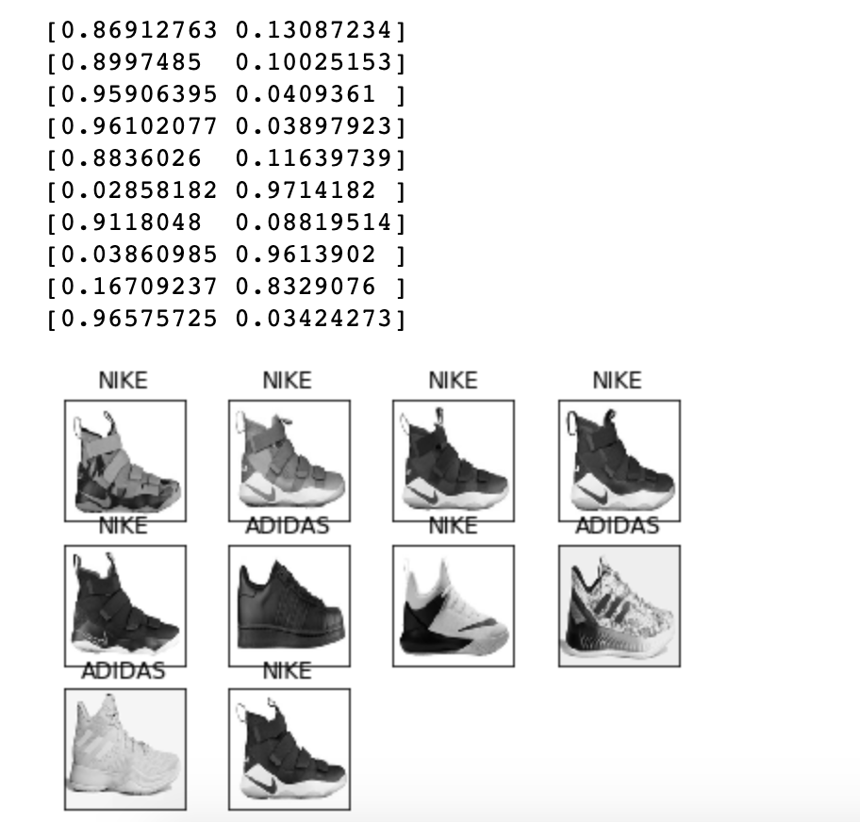

Extreme Cases or ‘Outliers’ 2
86% Accuracy
Developing a new algorithm

Slide 22
Next Step
Notes:
Results of mobile net (show the code of the results and show them the 55% accuracy)
Take out some theory slides out and explain the code during the code images
The last slide must talk about why we chose not to stick with this algorithm and why we wanted to create our last one.

Slide 23
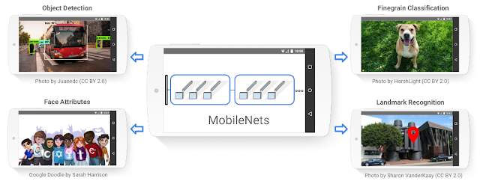
MobileNet
It is a fast and light-weight CNN model.
The architecture of it is come from Google, which aim to running on mobile device.
It make training faster
and save calculation resource.
Notes:
The Reason we started to use mobile net is because we wanted to experiment with create an algorithm used on mobile devices.
What is Mobile net?
Our first algorithm is mobilenet, the reason of why we choose this one is because we wanted to experiment with create an algorithm used on mobile devices. It is…...

Slide 24
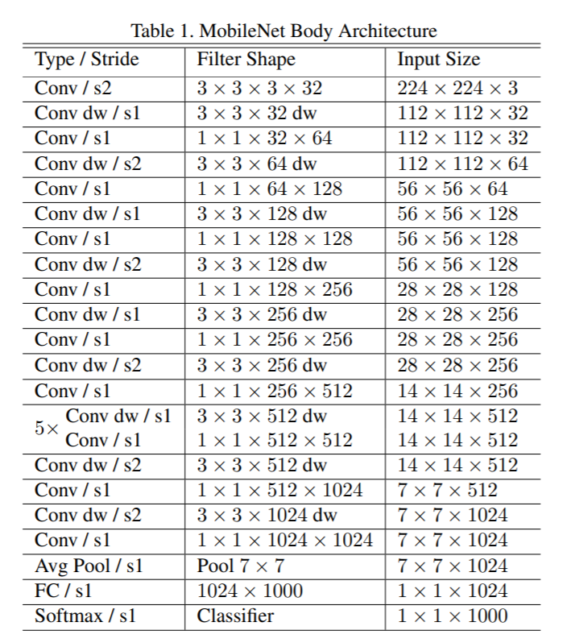
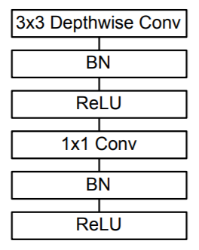
MobileNet
The architecture of MobileNet has 30 layer. It is start from a regular convolution, then insert 13 pairs of depthwise separable convolution.
Each pair of depthwise separable convolution contain one depthwise convolution and one pointwise convolution.

Slide 25
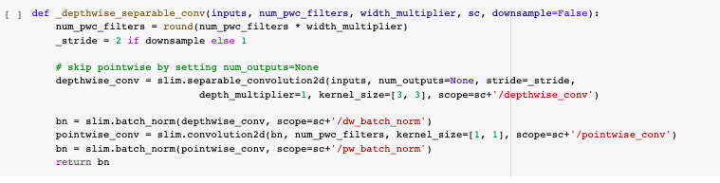
Depthwise separable convolution

Slide 26
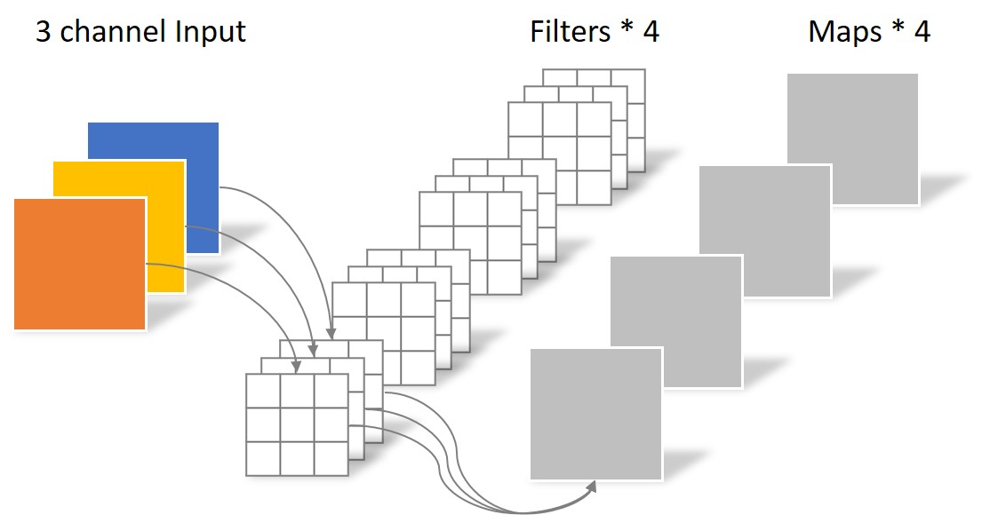
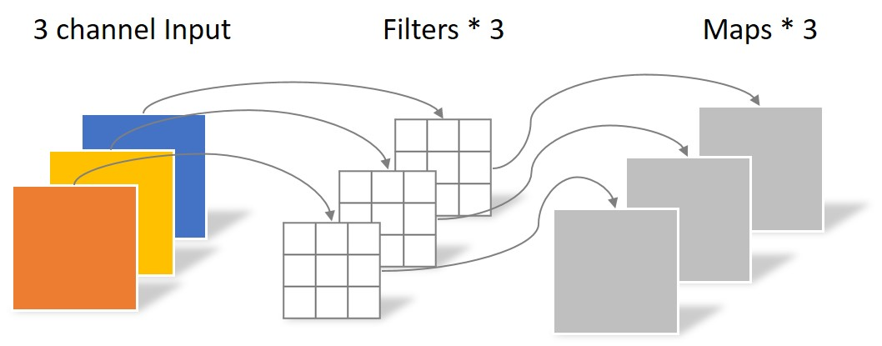
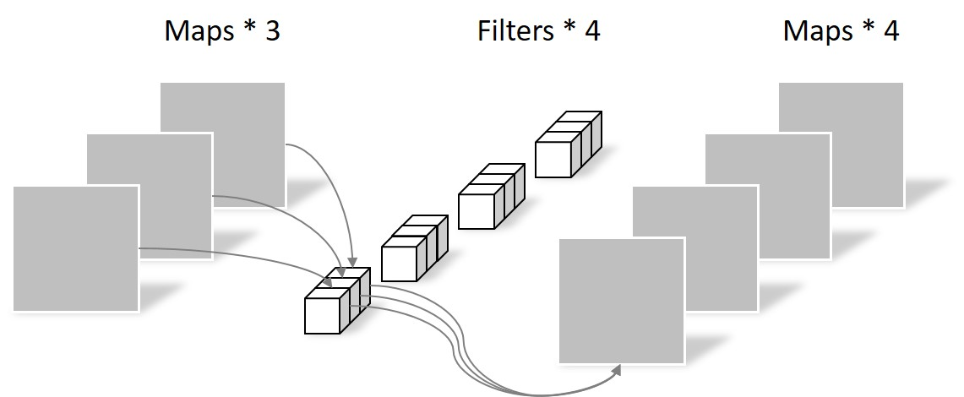
Convolution
Standard convolution
If our input layer is a 3 channel image, we have a convolution layer with 4 filters, a 3x3 kernel for each channel, and it will output 4 feature maps, which have same size of input layer.
The convolution operation parameters is 4 x 3 x 3 x 3 = 108
Depthwise convolution
First we only do a 2D convolution operation. For a 3 channel image, it will apply 3 filters with one 3x3 kernel. The output will be 3 maps, each map only have feature with one channel.
The convolution operation parameters is 3 x 3 x 3 = 27
Pointwise convolution
In this convolution we make 4 filters as the standard convolution. But the kernel is 1x1x3. That will make the same feature maps as the standard convolution.
The convolution operation parameters is 4 x 3 x 1 x 1 = 12
Total is 27 + 12 = 39

Slide 27
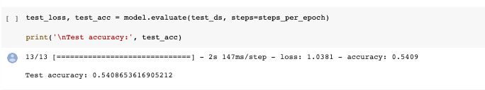
Result
Notes:
It is a pretty good algorithm, it is make train time short. But the accuracy is lower too. This is the accuracy I got, It is only 54%. So we decide to looking for a new algorithm.

Slide 28
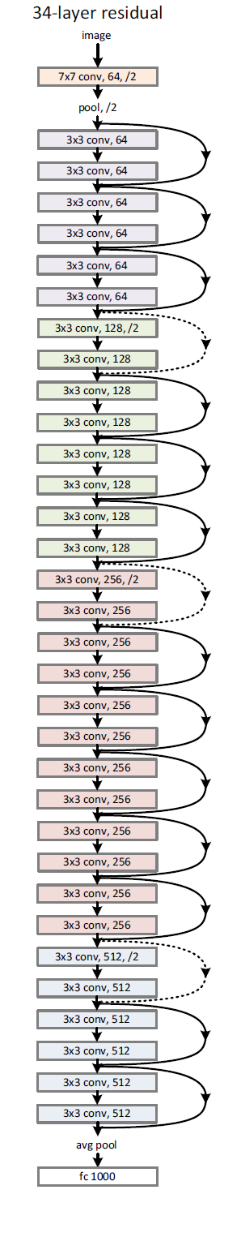
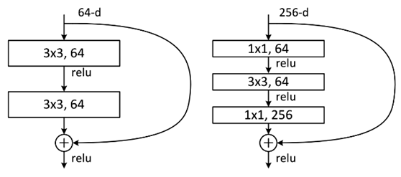
Residuals Net
It is another architecture that come from Google, which aim to add more layer in the model.
Notes:
The residual Net is the new architecture that we use. The residual Net is

Slide 29
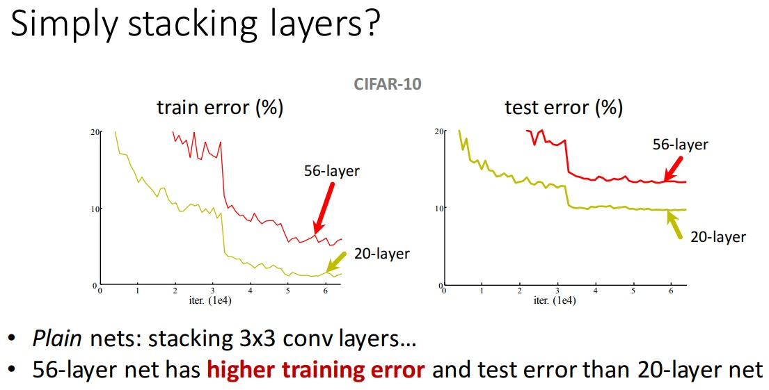
Why Residual Net?
Notes:
Why we want the residual block? Because we want more layer in our model and we want our model have more feature. But the truth is that if we just plain nets, the accuracy will not go higher, instead, the error rate goes higher. Because the convolution may lose some feature. So what should we do? We use the Residual Block.

Slide 30
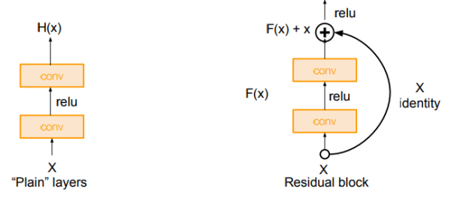
Residual Block
Notes:
The residual block is put two or three convolution layer together. Then we add those feature from the beginning of the block to the end of the block. Therefore the convolution will not make any loss.

Slide 31
Our Deployment Website
Notes:
Results of mobile net (show the code of the results and show them the 55% accuracy)
Take out some theory slides out and explain the code during the code images
The last slide must talk about why we chose not to stick with this algorithm and why we wanted to create our last one.

Slide 32
Frontend Github Pages
Used github pages to demo our project and show all material.
Able to access code, data and google colab through our pages.
https://ccnyundergraduatecsdegree.github.io/SneakerApp/

Slide 33
Final Algorithm
Notes:
Results of mobile net (show the code of the results and show them the 55% accuracy)
Take out some theory slides out and explain the code during the code images
The last slide must talk about why we chose not to stick with this algorithm and why we wanted to create our last one.

Slide 34
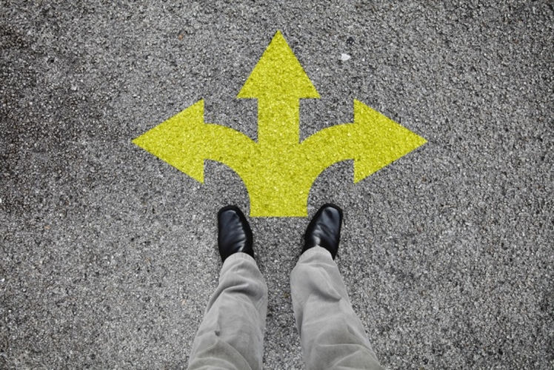
Pivot
During our last two meetings our group decided to pivot our project to detecting the company shoe instead of the model.
We also decided to take out the Jordan brand because the images were giving us issues.
Notes:
During the last two meetings our group noticed the challenges with separating our data into individual sneakers. Since we started off with 4 companies and 3 shoes respecitly for each, our data was not only marginalized 12 times but our model had less training data for each. After meeting with the team, we decided to not only make our model use sneaker companies but also take out the Jordan brand because the test images were inconsistent and had too many variations to have the model accurate. This pivot not only allowed us to be more consistent with our data but allowed us to use more of our extreme photos of certain company shoes since our data was being combined.

Slide 35
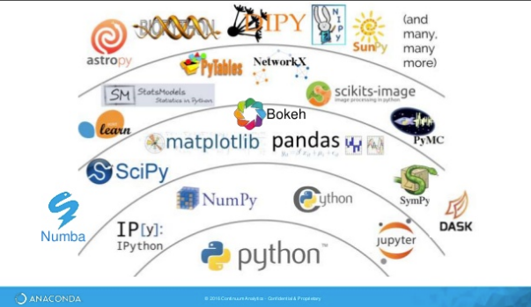
Technologies Used
During the final script we decided to use google colab to work together and create our version of our learning algorithm.
We then used the following Libraries:
Fastai
matplotlib
Pandas numpy
Notes:
Technologies used, I.E. (How we mounted our data)
And Libraries used

Slide 36
Libraries Explained
Fastai: Gives us the necessary functions to define a dataset and train a model.
matplotlib: The resulting plots will be stored in the notebook document.
pandas: When working with tabular data, such as databases, Pandas helps us explore, clean, and process data.
numpy: NumPy can also be used as an efficient multi-dimensional container of generic data. Arbitrary data-types can be defined. This allows NumPy to seamlessly and speedily integrate with a wide variety of databases.
Notes:
Fastai
The vision module of the fastai library contains all the necessary functions to define a Dataset and train a model for computer vision tasks. It contains four different submodules to reach that goal: vision.image contains the basic definition of an Image object and all the functions that are used behind the scenes to apply transformations to such an object. vision.transform contains all the transforms we can use for data augmentation. vision.data contains the definition of ImageDataBunch as well as the utility function to easily build a DataBunch for Computer Vision problems. vision.learner lets you build and fine-tune models with a pretrained CNN backbone or train a randomly initialized model from scratch. Each of the four module links above includes a quick overview and examples of the functionality of that module, as well as complete API documentation. Below, we'll provide a walk-thru of end to end computer vision model training with the most commonly used functionality.
Matplotlib
IPython has a set of predefined ‘magic functions’ that you can call with a command line style syntax. There are two kinds of magics, line-oriented and cell-oriented. Line magics are prefixed with the % character and work much like OS command-line calls: they get as an argument the rest of the line, where arguments are passed without parentheses or quotes. Lines magics can return results and can be used in the right hand side of an assignment. Cell magics are prefixed with a double %%, and they are functions that get as an argument not only the rest of the line, but also the lines below it in a separate argument. With this backend, the output of plotting commands is displayed inline within frontends like the Jupyter notebook, directly below the code cell that produced it. The resulting plots will then also be stored in the notebook document.
Pandas
When working with tabular data, such as data stored in spreadsheets or databases, Pandas is the right tool for you. Pandas will help you to explore, clean and process your data. In Pandas, a data table is called a DataFrame.
NumPy
NumPy is the fundamental package for scientific computing with Python. It contains among other things: a powerful N-dimensional array object, sophisticated (broadcasting) functions, tools for integrating C/C++ and Fortran code, useful linear algebra, Fourier transform, and random number capabilities. Besides its obvious scientific uses, NumPy can also be used as an efficient multi-dimensional container of generic data. Arbitrary data-types can be defined. This allows NumPy to seamlessly and speedily integrate with a wide variety of databases.
Inline
For inline plotting, commands in cells below the cell that outputs a plot will not affect the plot. For example, changing the color map is not possible from cells below the cell that creates a plot. However, for other backends, such as Qt5, that open a separate window, cells below those that create the plot will change the plot - it is a live object in memory.

Slide 37
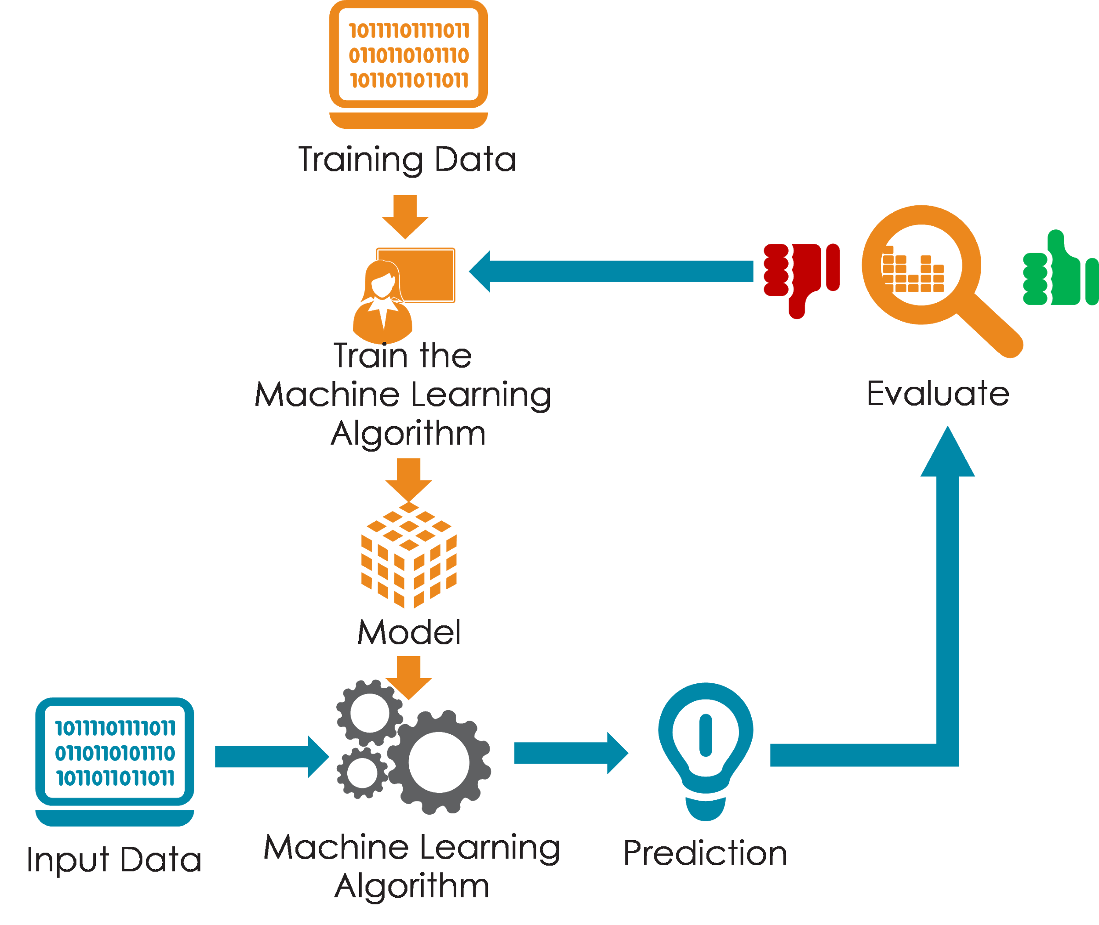
Data Used
The data used for the final script was significantly increased.
At the end we provided more than 200 photos to help train our algorithm.
This not only gave us the opportunity to train our model but gave us a bigger cross validation set.
In total we worked with 500+ images of shoes.
Notes:
How the data was used in the application?
The test data is around 16 % of the whole data set
While the train is the remaining 84%

Slide 38
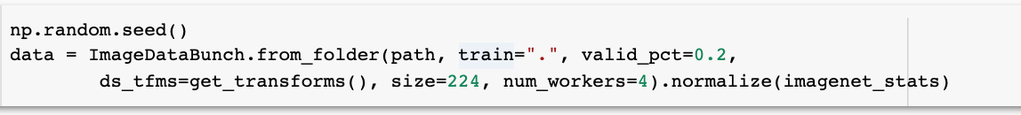
Data preparer
The data is broken to 20% validation set and 80% training the model.
Notes:
How was the training done, How many epoch and why?
The reason we fit one cycle for training our data is to see how the validation loss lowers and how the training loss rate drops.
num_workers is the number of CPUs to use, tfms, device and collate_fn are passed to the init method.
Valid pct show a 20% cross validation
get_transforms returns a tuple of two lists of transforms: one for the training set and one for the validation set

Slide 39
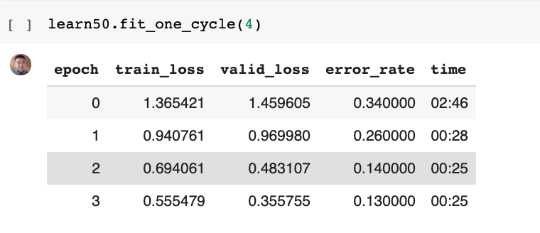
Training
Then we train the model with 4 epochs.
Notes:
wHAT IS VALIDATION LOSS? It is the sum of errors made for each example in training or validation sets. Loss value implies how poorly or well a model behaves after each iteration of optimization

Slide 40
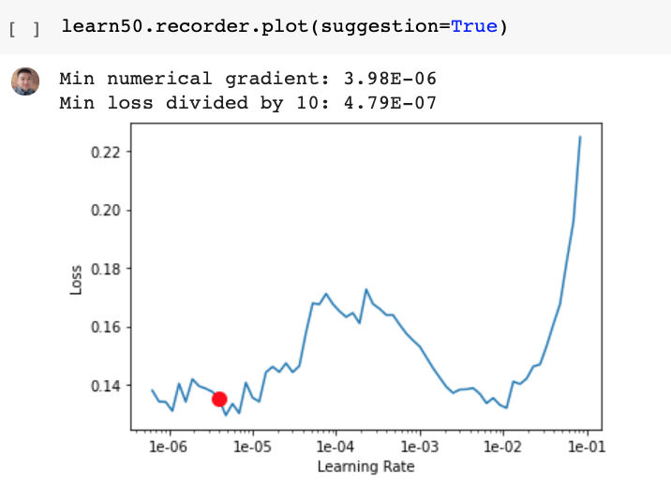
Graphs
Notes:
Explain what is happening in the graphs. \
If you pass suggestion=True in learn.recorder.plot, you will see the point where the gradient is the steepest with a red dot on the graph. We can use that point as a first guess for an LR.

Slide 41
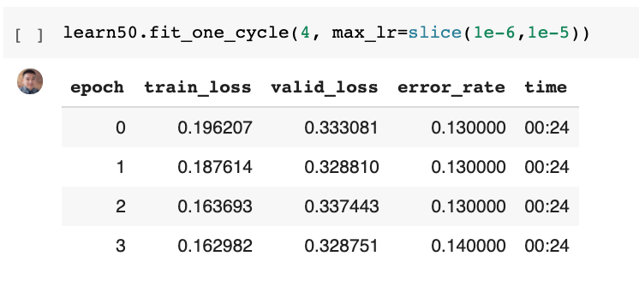
Graphs
Notes:
Explain what is happening in the graphs. \
If you pass suggestion=True in learn.recorder.plot, you will see the point where the gradient is the steepest with a red dot on the graph. We can use that point as a first guess for an LR.
If validation loss > training loss you can call it some overfitting.
(Overfitting refers to a model that models the training data too well. Overfitting happens when a model learns the detail and noise in the training data to the extent that it negatively impacts the performance of the model on new data.)
But the goal is to the validation loss as low as possible. Some overfitting is nearly always a good thing. All that matters in the end is: is the validation loss as low as you can get it.

Slide 42
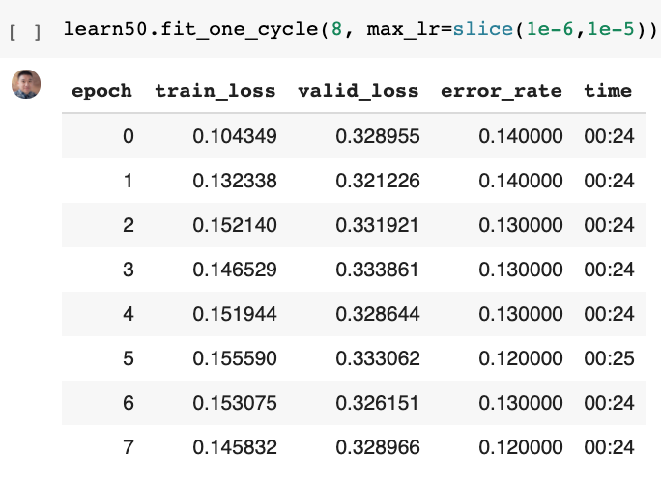
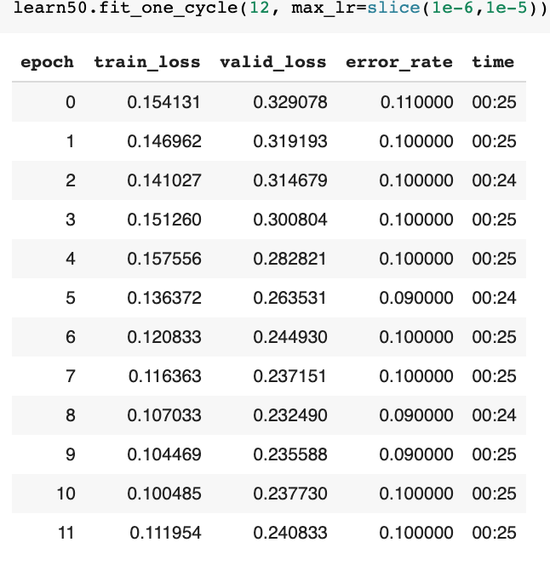
Graphs
Notes:
In the first image we still have overfitting since validation loss > training loss you can call it some overfitting.

Slide 43
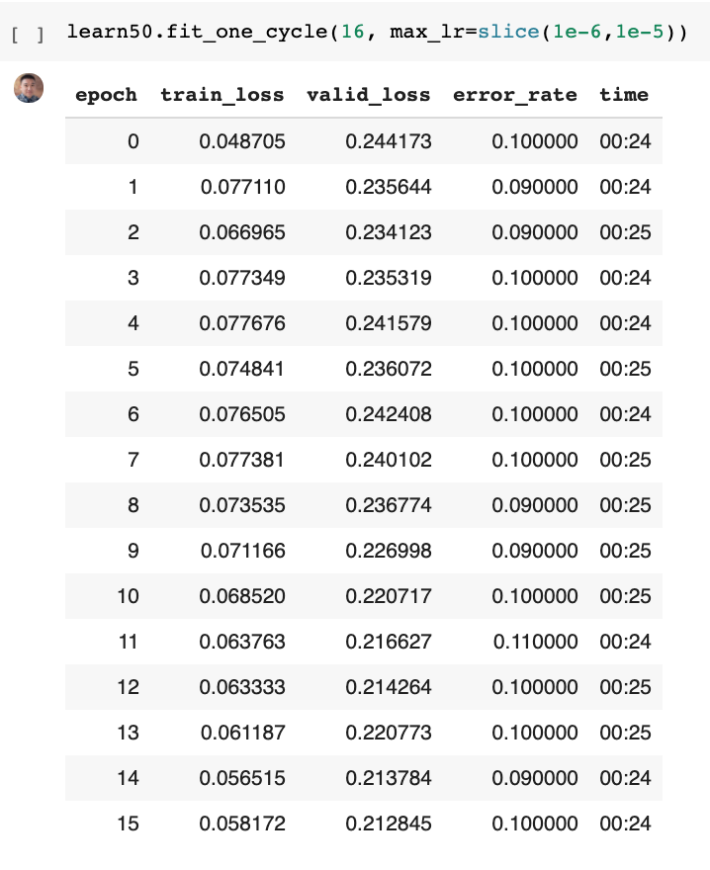
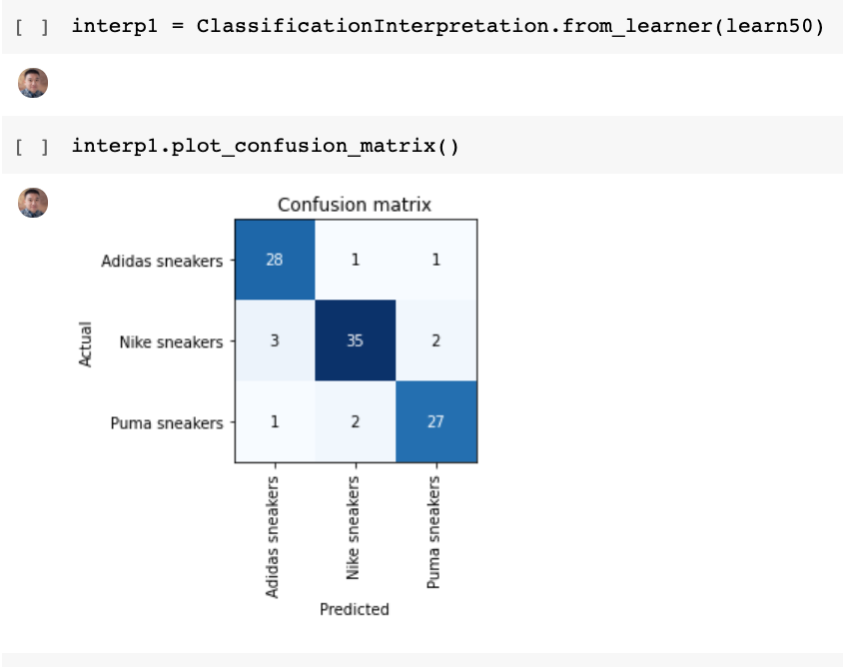
G
R
A
P
H
s
Notes:
In the last run with 16 epoch we achieved the small validation possible that google colab would allow us. This made us certain that if we increased our epoch our algorithm would learn better.
A confusion matrix is a table that is often used to describe the performance of a classification mode on our set of test data for which the true values are known. It allows the visualization of the performance of an algorithm.
Explain what is happening in the graphs.

Slide 44
Test Images
Notes:
For our majority of our project time we had 33 images that we were testing on, but recently we increased it to 100 images.
This is just to remind the audience what the test images looked liked

Slide 45
Prediction CODE

Slide 46
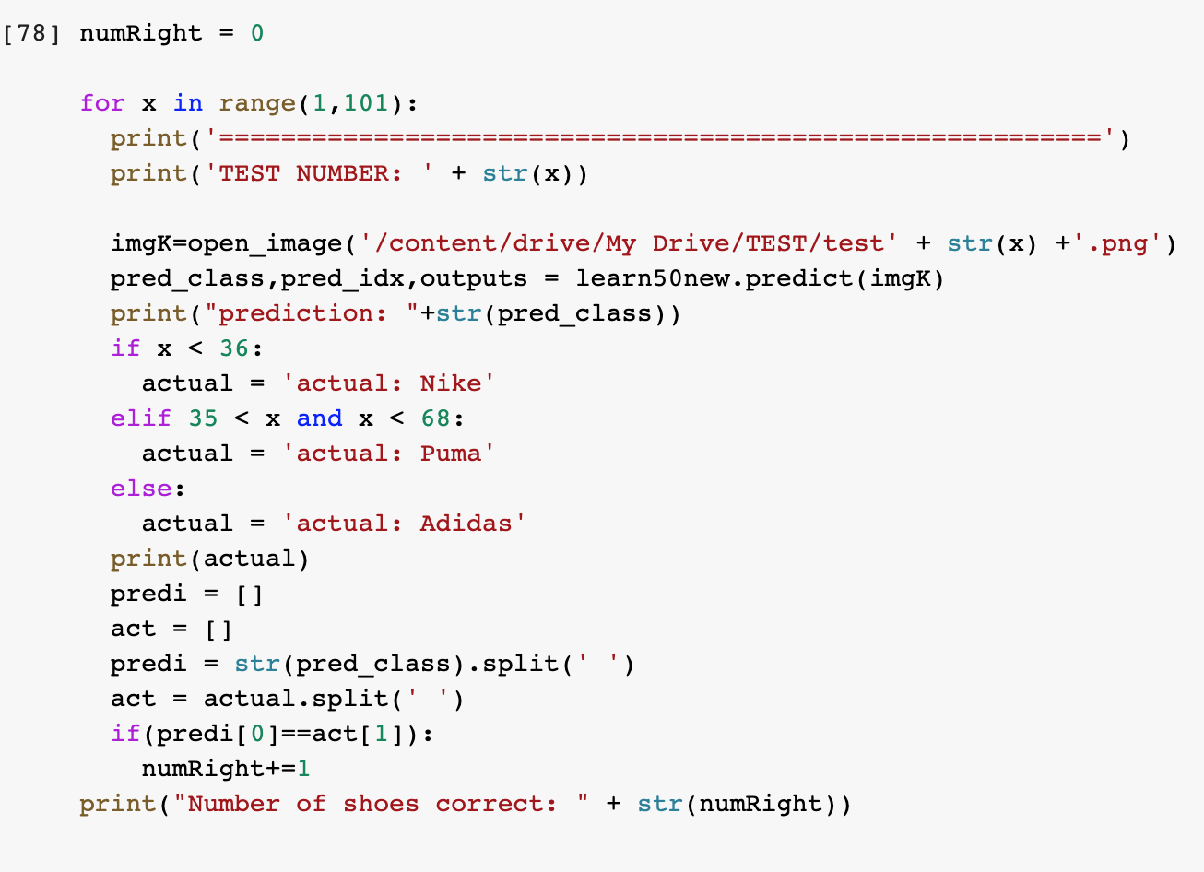
Test Images

Slide 47
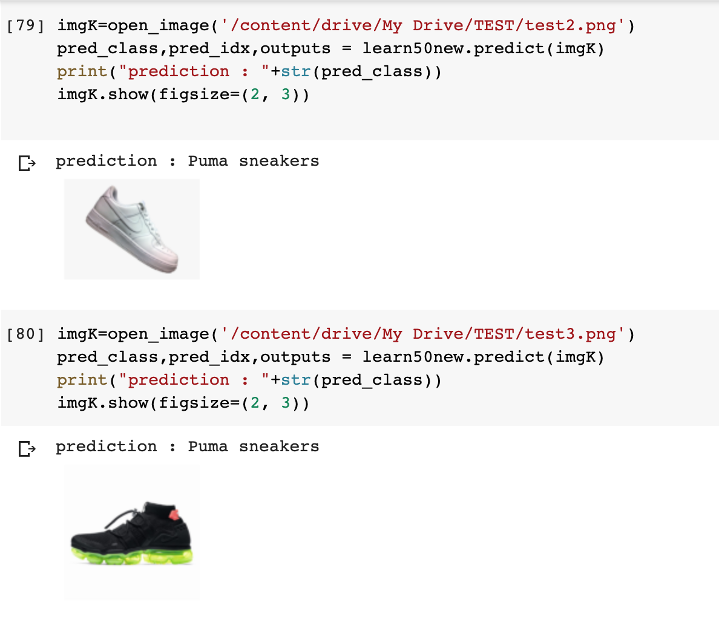
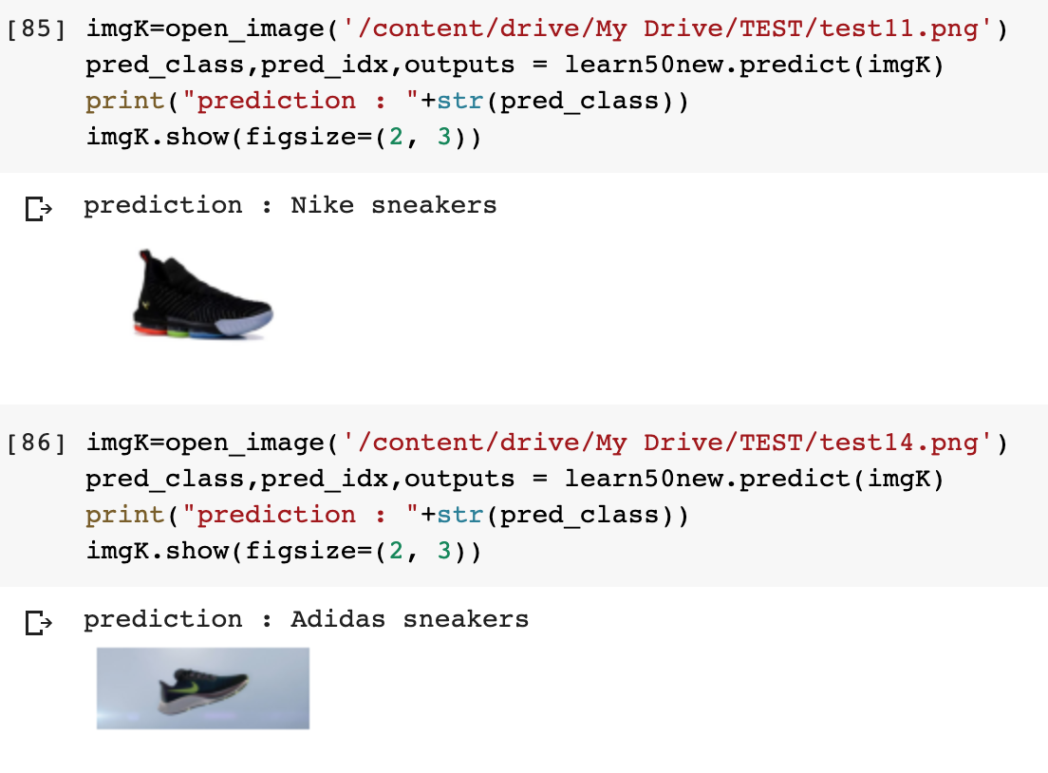
Predictions

Slide 48
Results
This model gave us a 92% accuracy of predicting the shoe company.
We know this can be improved even more if Google Colab gave us unlimited Ram so we could run even more epoch training to our algorithm and add more to our datasets respectively.
Since our research shows that published machine learning algorithms usually have thousands of epoch trainings to minimize error.

Slide 49
THANKS!
Stay Home &
Stay Safe
Stay Home &
Stay Safe

